Slide 1
Direct Methods

Slide 2
Direct Methods
Direct method search using function evaluations only
Also called zero-order, black box, pattern search, or derivative-free methods

Slide 3
Cyclic Coordinate Search
Also known as coordinate descent, or taxicab search
Performs line search in alternating coordinate directions

Slide 4
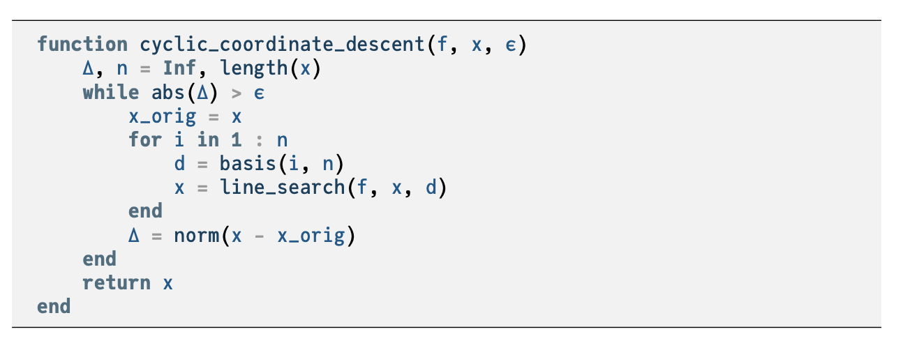

Slide 5
Cyclic Coordinate Search
Can be augmented to accelerate convergence

Slide 6
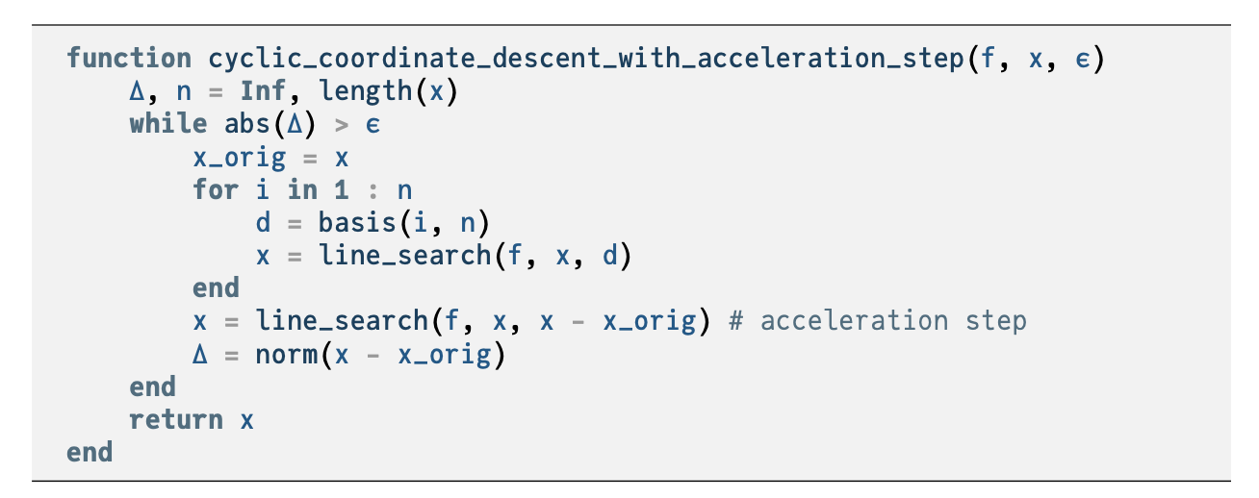

Slide 7
Powell’s Method
Similar to Cyclic Coordinate Search, but can search in non-orthogonal directions

Slide 8
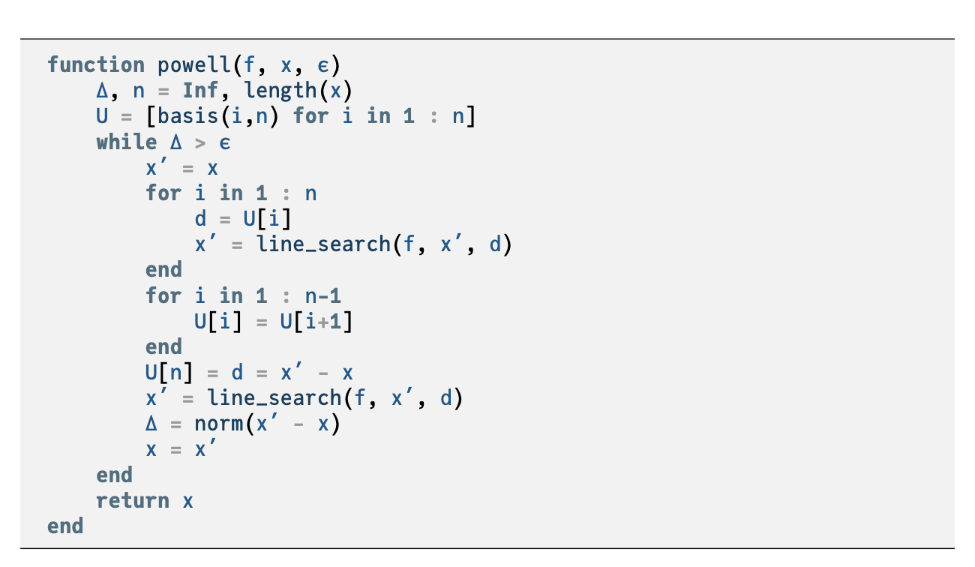

Slide 9
Hooke-Jeeves

Slide 10
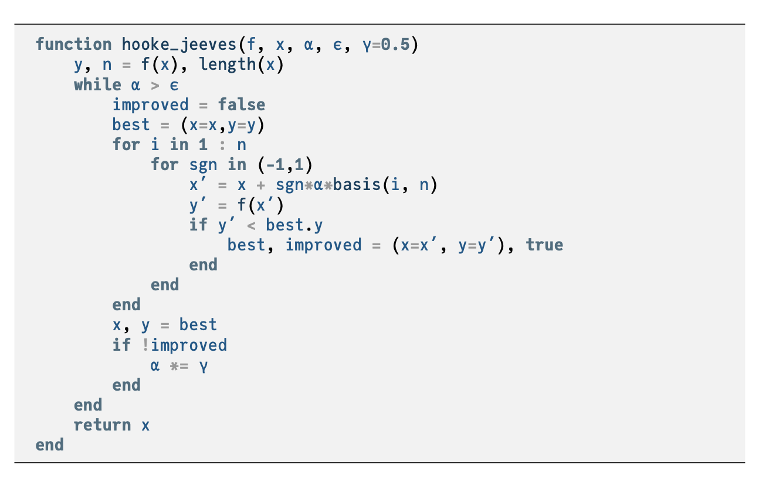

Slide 11
Summary
Direct methods rely solely on the objective function and do not use derivative information.
Cyclic coordinate search optimizes one coordinate direction at a time.
Powell’s method adapts the set of search directions based on the direction of progress.
Hooke-Jeeves searches in each coordinate direction from the current point using a step size that is adapted over time.

